Slide 1
Prey Anti-Theft
21 Feb 2018
Phoenix IT Roadshow
Alfred Chan

Slide 2
Agenda
Prey (Video) Introduction
Features
Costs
Short Demonstration

Slide 3
Prey Introduction

Slide 4
Features
Free
Track 3 Free devices (as long there is an internet/GPS connection)
Control Zone
Nonfiction and Reports (20 reports/device// 100 reports paid)
Alarm/Alert/Lock
Camera/Image capturing
Compatible with most current OSs: Android, MacOS, iOS, Windows, Linux, Ubuntu
Paid
Track 10+ devices
Remote Date Wipe/Retrieval
Reports increased to 100 and auto managed
Faster Report Frequency

Slide 5
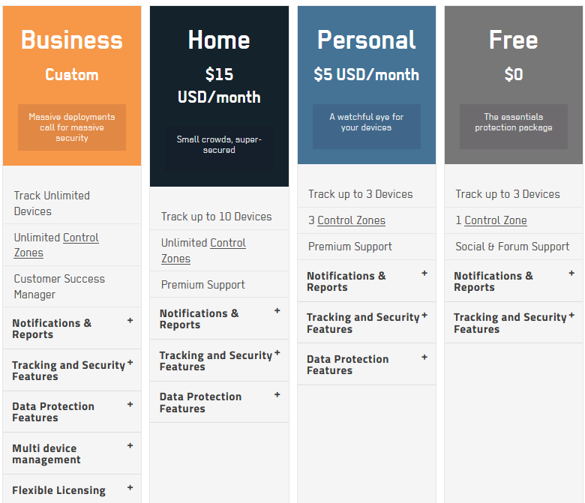
Costs
REF: https://www.preyproject.com/pricing

Slide 6
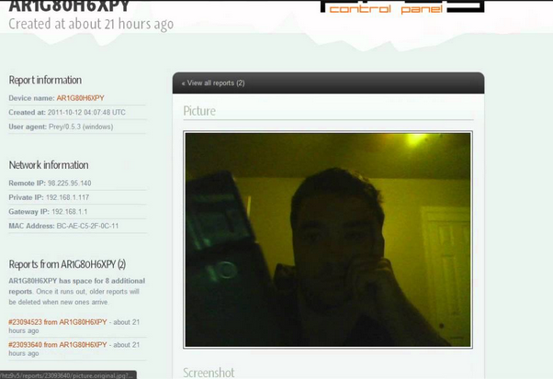
Short Demonstration
Remote Alarm and Locking
Sample Photo Report

