Slide 1
Bioinformatics
Campus and Phoenix Resources

Slide 2
Available:
UCD
Bioinformatics Core
CAES Farm
Phoenix
PLP: Odin & Athena
Bioinformatics.phoenix.ucdavis.edu

Slide 3
Bioinformatics Core
bioinformatics.ucdavis.edu
Provides:
Data analysis
Research computing
Training

Slide 4
Bioinformatics Core : Data Analysis
Recharge rate of $97/hr, for project work, consulting or providing letters of support
Wide range of topics, including:
Sequence QC, e.g. adapter trimming
Genome and transcriptome assembly
Analysis of metagenomics and metatranscriptomics datasets
ChIP-Seq analysis
Microbial genomics
Pathway enrichment analysis
Comparative genomics
Analysis of epigenetic modifications, e.g. from methylation/chromatin data
Variant calling
Analysis of RNA-Seq data
Blast2GO annotation analyses

Slide 5
Bioinformatics Core: Research Computing
Software Development
Sickle (windowed adaptive trimming tool for FASTQ files using quality)
Scythe (very simple adapter trimmer)
qrqc (Quick Read Quality Control)
Sabre (barcode demultiplexing and trimming tool for FASTQ files)
System Administration

Slide 6
Bioinformatics Core: Training
Training events
Documentation

Slide 7
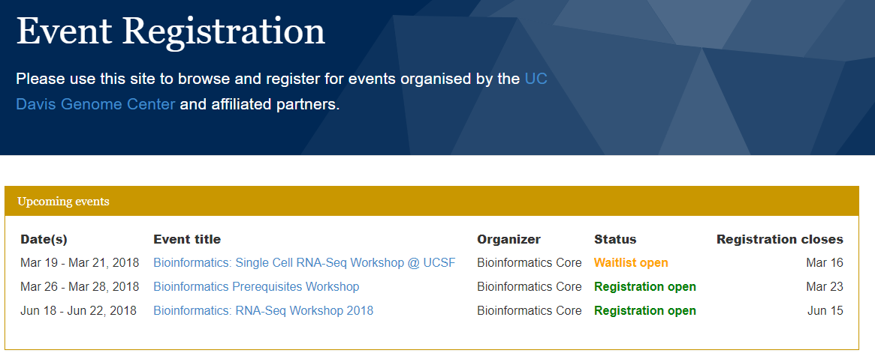
Bioinformatics Core: Training Events

Slide 8
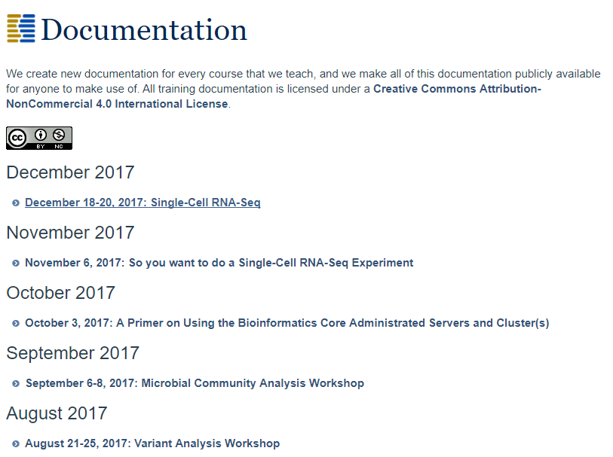
Bioinformatics Core: Documentation

Slide 9
CAES Farm
The FARM is a High Performance Computing (HPC) Cluster for use by CAES
For “free” access, there are 72 computer nodes (24 cores per node, 2 threads
per core; 64GB RAM per node)
For department members of Entomology and Nematology, 2 “HighMem” nodes (48 cores per node, 2 threads per core;
512GB and 1TB RAM) are available.
System runs Ubuntu 14.04 and wide variety of software already installed.
Specific software can be installed by request

Slide 10
CAES Farm
Plant Pathology has free access to Low and Medium Priority queues
Ent/Nem users have access to a departmentally-purchased node

Slide 11
Phoenix Cluster Resources
https://bioinformatics.phoenix.ucdavis.edu
Information on Farm access
Slurm tutorial
Ubuntu Bio-linux virtual machine
Email lists
For Plant Pathology users: information about the Storer 4204 Bioinformatics Lab

Slide 12
Questions?

